Slide 1
POKEMON FIGHT SIMULATOR

Slide 2
POKEMON FIGHT SIMULATOR:
A 2-player game where players chooses from a list of characters and duel against each other till one player emerges victorious.
1: The pokemons are divided into types/categories such as “water, fire , rock, , flying , electric, ground , leaf” each with different strength or weakness against another type
2. Each pokemon has 4 moves and each move/spell has a power point
3. Each User/player chooses a from a list of Pokemon and duel against each other
4. When a pokemon’s health is <= 70% during the fight, it evolves into another pokemon character with increased health, and acquires the new characters moves/spell ( evolves only during a fight)
5. The fight continues until a pokemon gets to 0, the other pokemon(player) wins the duel

Slide 3
Pseudocode
Define list of pokemon
define type (e.g. water, fire etc) for each pokemon via dictionary (pokemon: type)
Define moves/attack for each pokemon via dictionary (pokemon: attack-name)
Define attack-power for each attack via dictionary (attack-name: number)
Define type for each attack via dictionary (attack-name: type)
Define effective type for each attack (e.g. fire strong against leaf, bug) via dict (attack: leaf, fire)

Slide 4
7:Define weakness type for each attack (e.g. fire weaker against water) via dict (attack: water)
8:Prompt user to select pokemon from list
9: Select attack from offered list of pokemon
10:Get power of each move
11:Check attack-power and type of attack (extra damage or less dmg ) against enemy type
12:Remove HP from both players according to damage (and extra dmg) from chosen attack
13:Check if any player reach 0 Hitpoints(HP)
14:If not, go back to select new move
15:II HP of player=0 → Exit game
16:Display winner

Slide 5
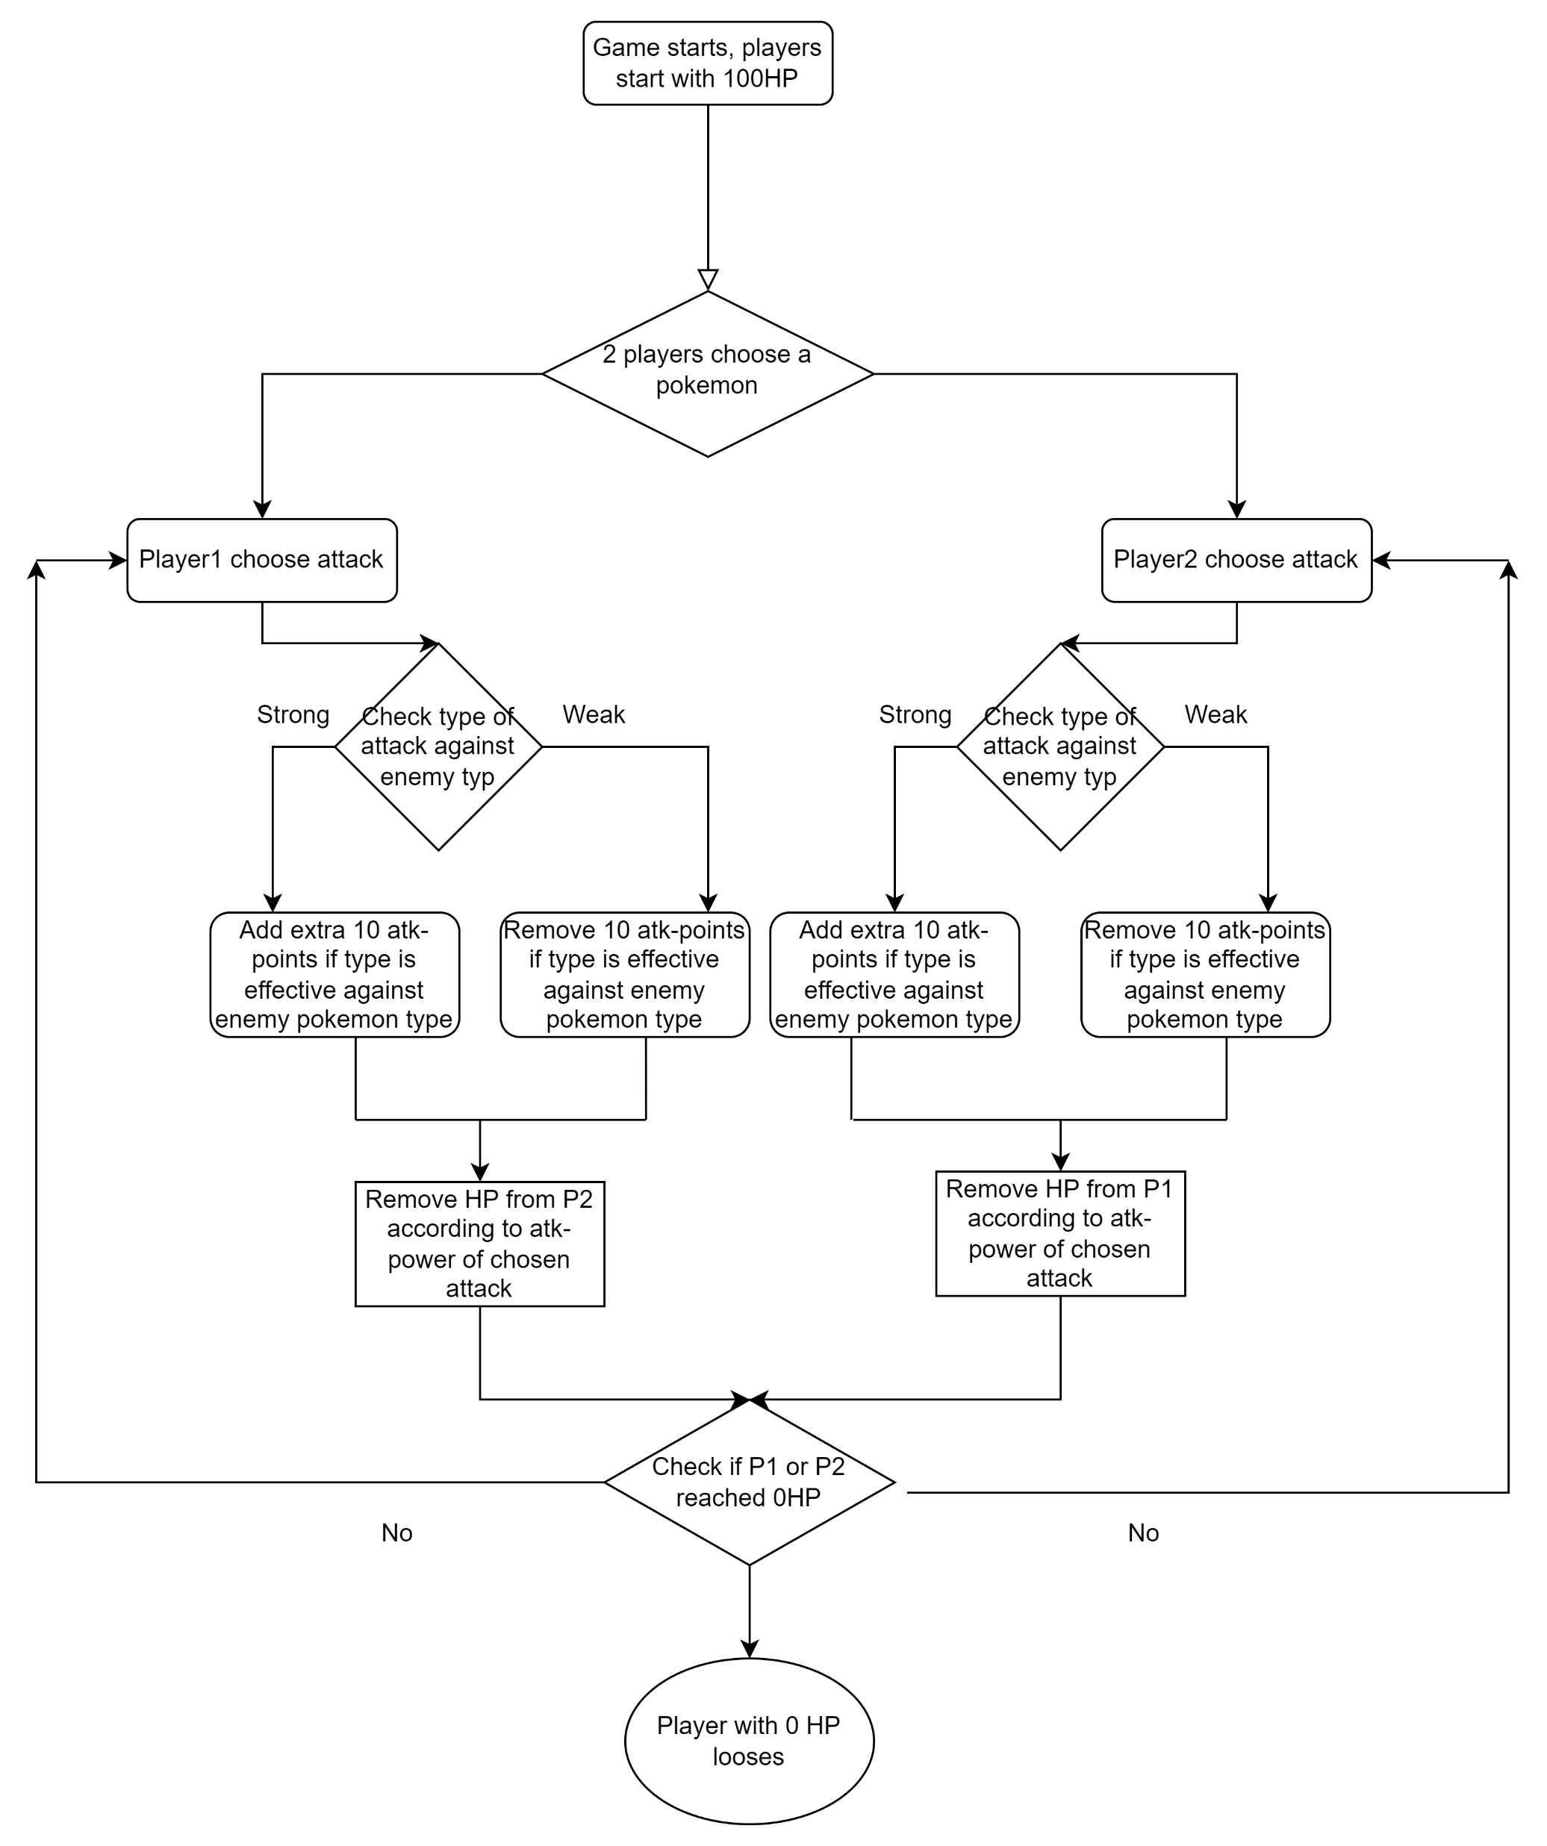
FLOWCHAT

Slide 6
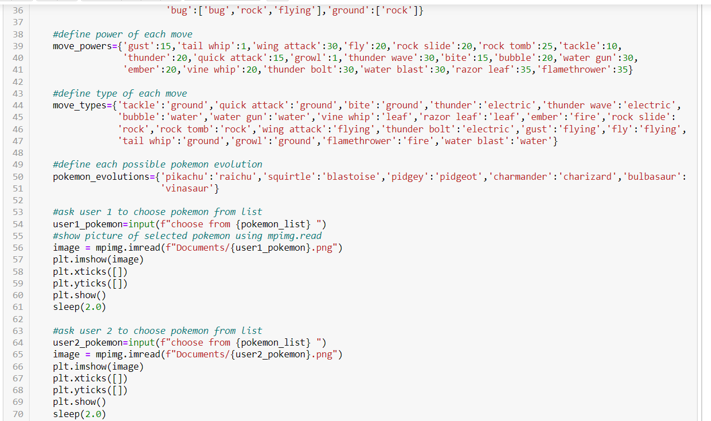

Slide 7
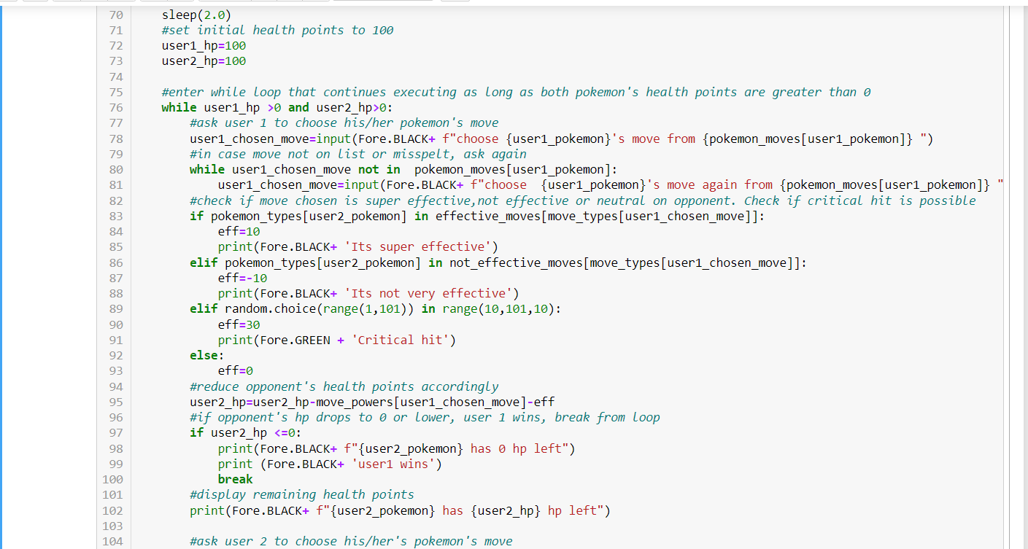

Slide 8
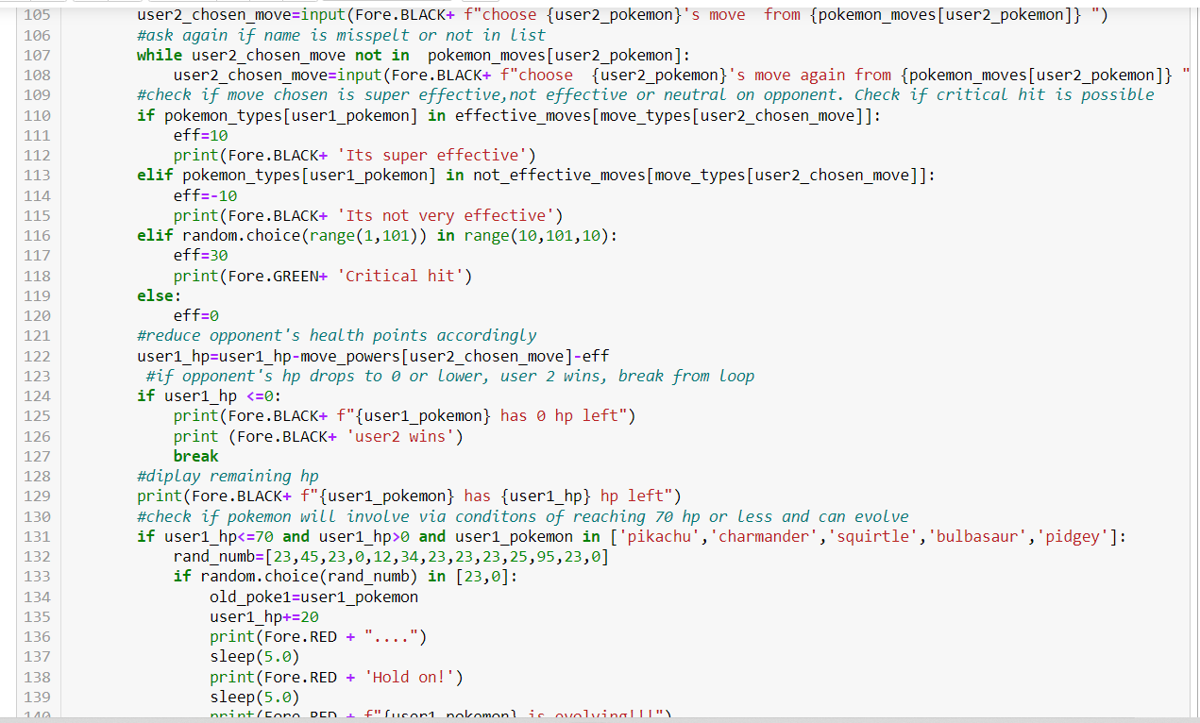

Slide 9
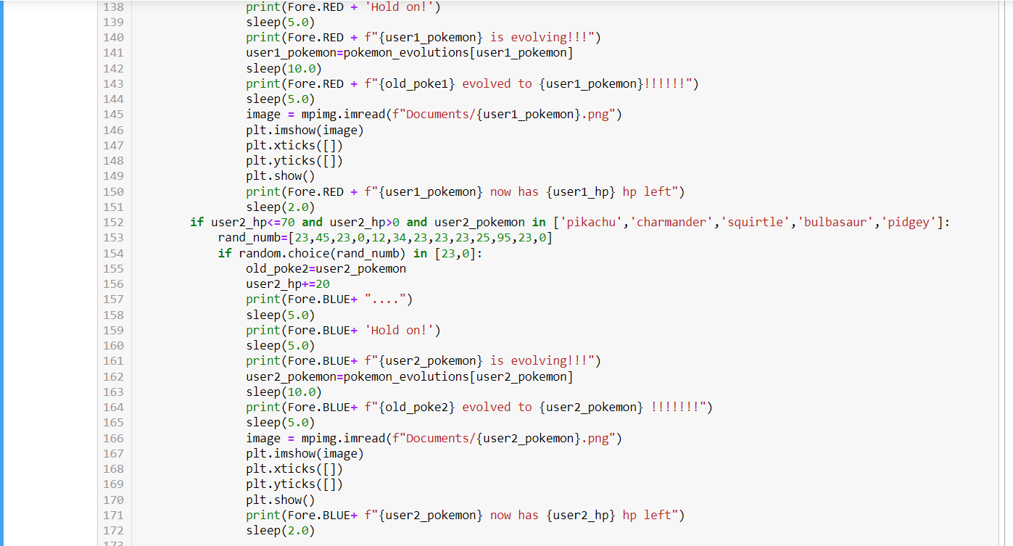

Slide 10
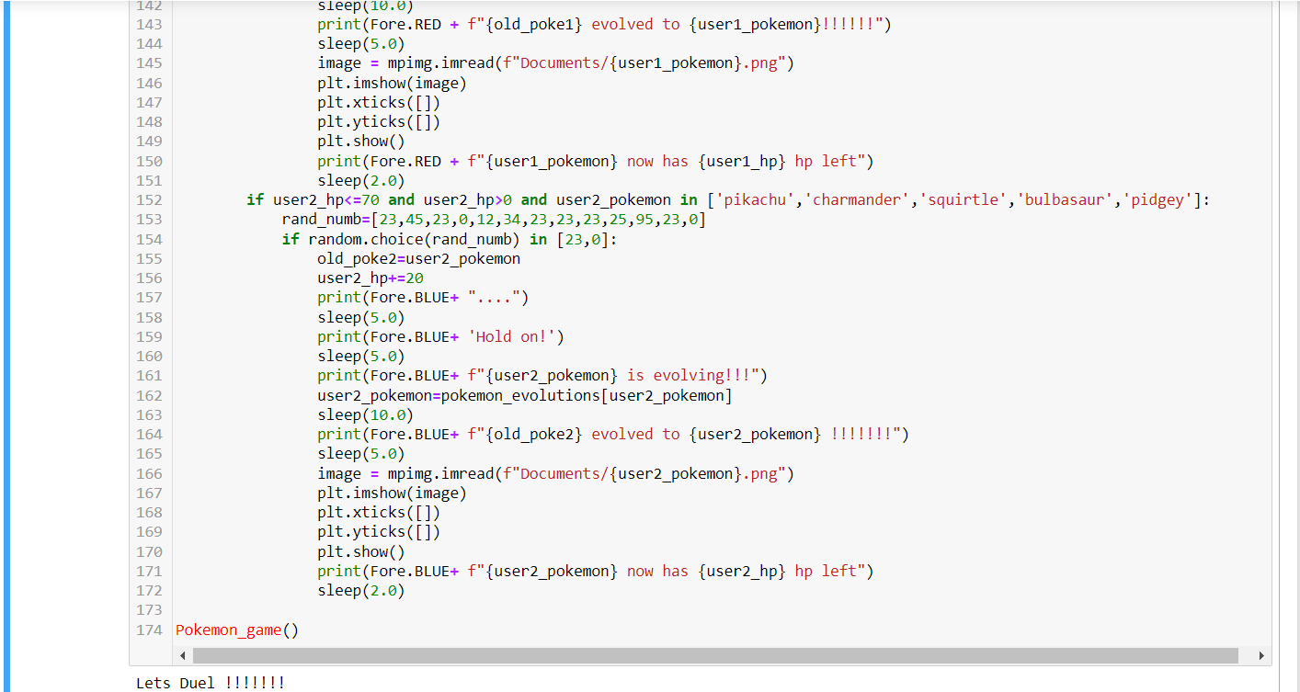

Slide 11
MERCI!

